Slide 1
Industrial visit
Presentation

Slide 2
Feasibility study on pvc pipe manufacturing plant
Mahesh extrusions private limited Ballari

Slide 3
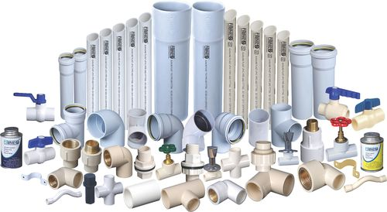
PVC Pipe

Slide 4
Contens
Introduction
Market
Raw material
Process Technology

Slide 5
What is PVC ??
The full form of PVC is Poly Vinyl Chloride. PVC is a polymer which is made from vinyl chloride polymerisation. PVC is being used in a variety of products, including raincoats, wires, pipes, bottles, credit cards, flooring, etc. Since it resists water and fire, it is useful in producing many products.

Slide 6
RAW MATERIAL
PVC Resin
Calcium
1 pack Stabillizer
Color (G,R,B,W)

Slide 7
PROCESSING
Extrusion
Plasticizers
Stabillizers
Lubricants
Fillers

Slide 8
PROCESSING :
Extrusion:
Extrusion is a process where a material undergoes plastic deformation by the application of a force causing that material to flow through an orifice or die.

Slide 9
Plasticizers:
The Plasticising process
Heating PVC resin causes molecular agitations that become stronger than its intermolecular forces, thus widening the distances between the molecules and resulting in the softening of the resin. Plasticizers are then added to the PVC, placing themselves between the distanced PVC molecules.

Slide 10
Stabillizers:
The process of stabilization happens by bringing voltage to a desirable level whenever there is any kind of fluctuation in the power system.

Slide 11
Utility:
Electricity
Gas
Water

Slide 12
Environmental Impact:
Toxic level
Pollution level
Impact on Local community
Impact on environmental resources

Slide 13
Market Demand:
Market demand describes the demand for a given product and who wants to purchase it. This is determined by how willing consumers are to spend a certain price on a particular good or service. As market demand increases, so does price. When the demand decreases, price will go down as well.

Slide 14
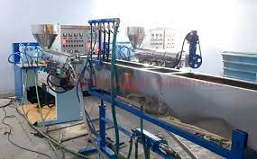
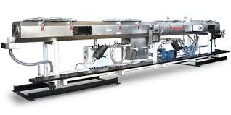
Machinerys:

Slide 15
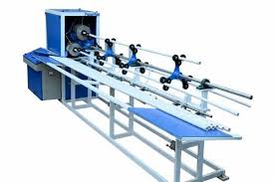
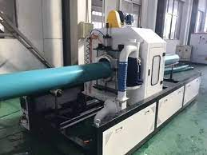
AUTO SOCKETING MACHINE
CUTTING MACHINE

Slide 16
THANK YOU……….

